Slide 1
Fire detection system app
User Manual
Author: Abhinav.K

Slide 2

Table of Contents
Acknowledgements
About me
About my Internship with Clevered
About the app
How to use the app
Contact Information

Slide 3
Acknowledgements
Firstly I would like to thank my parents for introducing me to this Internship. Secondly i would like to thank Avishek sir who helped and guided me throughout the Internship and also making this Internship interesting.

Slide 4

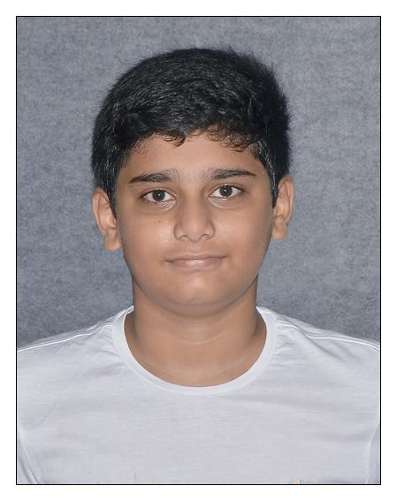
About Me..
Abhinav.K
Currently in class 8
Currently enrolled in Clevered

Slide 5
About My Internship Journey with Clevered
The Internship was very interesting and very collaborative. I had a wonderful experience with Avishek sir as he guided out me through the internship and making it a fantastic journey.
Although i have interest in learning AI but after the internship, now the my interest has increased a lot.Iam very thankful to everyone who had made this journey possible.

Slide 6
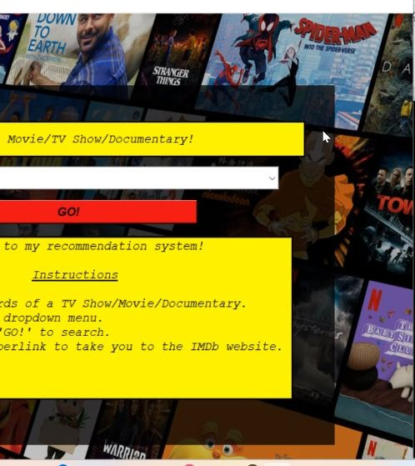
About App..
App’s Introduction

Slide 7
How do I use the App?

Slide 8
Content-Based Filtering
•

Slide 9
Collaborative Filtering
filtering is a technique that makes movie
tions based on user behavior. It uses the ratings given by s to predict how a user might rate a particular movie. In gular Value

Slide 10
Metadata-Based Filtering
ses metadata associated with movies, such as genres, vote averages. It filters movies based on popularity and quality, ommendations include well-received and widely-watched

Slide 11
Hybrid Recommendations
nes both content-based and collaborative filtering to provide ndations. This approach leverages the strengths of both
cing the accuracy and diversity of movie suggestions. It ated ratings from collaborative filtering and then combines nt-based similarity scores to generate recommendations
' preferences.

Slide 12
Contact Person
Please reach out to Abhinav.K at abhinav392011@gmail.com for any questions,concerns or suggestions on the App

Slide 13
Thank you!

